Slide 1


Slide 2


State of the 2020 Race in
Core Battleground States
Key findings from a survey among voters in FL, MI, PA, and WI
conducted May 1 to 8, 2019 on behalf of Priorities USA
Notes:
12654a
Note: vertical expressions for subgroups except where noted

Slide 3
Poll Methodology
Online survey conducted May 1 to 8, 2019, among 1,600 registered voters across four key battle-ground states: Florida, Michigan, Pennsylvania, and Wisconsin
12% did not vote in 2016
  Among those who did vote, 47% voted Clinton, 48% voted Trump
Overall results have been weighted in proportion to the share of electoral voters per state

Slide 4
Opposition to Trump is more unified than his support
2020 Presidential Trial Heat
 | Trump | Democrat
2016 Trump voters | 79% (54% definite) | 6%
2016 Clinton voters | 3% | 89% (71% definite)
2016 third-party voters | 12% | 46%
2016 nonvoters | 22% | 50%
47%
38%
Probably/
leaning
Probably/
leaning
Definitely
Definitely
Notes:
Q.8a

Slide 5
Undecided voters have overwhelmingly negative views of Trump
Undecided voters:
Say that what they have seen and heard lately has made them less favorable toward Trump:
Dislike Trump personally and disapprove of his job performance:
What I have seen/heard has made me
LESS favorable toward Trump
Probably/
leaning
Probably/
leaning
What I have seen/heard has made me
MORE favorable toward Trump
Definitely
Definitely
Notes:
Q.S3c, 9a, 6ab

Slide 6
There is room to grow for Democrats to mobilize key constituencies
How motivated and enthusiastic do you feel about voting in the 2020 elections?
85%
78%
80%
72%
71%
Very
motivated*
Extremely motivated*
Highly motivated
Less/not motivated*
* Based on ratings on a 0-to-10 scale: 10 = extremely motivated, 8-9 = very motivated, 0-7 = less/not motivated
Notes:
Q.7a

Slide 7
Trump is not accruing political benefit from what voters largely perceive as a humming economy
Assessment of the Economy
Trump’s handling of the
economy is more of a reason to:
Who do you trust more to deal with the economy?
Moving in the right direction
Reelect Trump
Trust Democrats more
Trust Trump more
Headed off on the wrong track
Elect someone with different approach
Notes:
Q.13a, 11b, 16a

Slide 8
The rising cost of living is more important to voters than jobs and stock market gains
When you think about the economy today, which is more important to you?
Notes:
Q.18

Slide 9
Voters are seeing many concerning economic trends up close in their own lives
Net getting better
-48
-20
-17
-5
+58
Cost of healthcare
Wages/incomes keeping up with cost of living
Economic situation for middle class/average working families
Economic situation for my family
Economic situation for people who already are wealthy
Notes:
Q.15

Slide 10
Voters trust Democrats over Trump on wages and helping the middle class
On looking out for the middle class
and average working families:
On raising wages:
49%
45%
39%
39%
Much better
Much more
Much better
Much more
Notes:
Q.16cd

Slide 11

Voters overwhelmingly perceive Trump as caring more about the wealthy and special interests than about them
Donald Trump cares mostly about:
Undecided voters:
46%
10%
Helping the average person
Helping the average person
Much more
16%
10%
26%
9%
Helping the wealthy and corporate special interests
Helping the wealthy and corporate special interests
Much more
46%
10%
56%
59%

Slide 12
How much have you personally benefited from Trump’s economic policies?
63% Little/Not
37% Lot/Some
45% Not at all
18% A little
25% Some
12% A lot
Midwest = 34% A lot/Some 66% Little/Not

Slide 13
On the issues that matter most to voters—healthcare first and foremost—Trump is at a significant disadvantage
Top Four Most Important Issues to Me (Selected from a List)
Trump’s handling of this is:
Unde- cideds
17%
52%
20%
43%
Healthcare
Wages and cost of living
Notes:
Q.4, 11b

Slide 14
Trump is losing on the issues he focuses on the most
Trump’s handling of this issue is:
Undecideds
19%
44%
34%
46%
34%
45%
Notes:
Q.11b

Slide 15
Fewer than two in five voters have money to put aside for savings—and that’s the only segment of the electorate currently backing Trump
Which of these best describes your current financial situation?
2020 Vote:
60% Trump
30% Democrat
2020 Vote:
31% Trump
51% Democrat
2020 Vote:
15% Trump
67% Democrat
I can pay my monthly bills and obligations, and have money to put aside for savings
I can pay my monthly bills and obligations, but am not able to put money aside for savings
There are some months when I struggle to pay my monthly bills and obligations
I am falling behind financially, and have gone into debt to pay my monthly bills and obligations
Notes:
Q.19b, 8a

Slide 16
Majorities of voters express worry about medical expenses, saving for retirement, and handling an emergency expense
Undecideds 65%
59%
Undecideds 64%
56%
Afr. Americans 67%
Age 18 to 34 65%
53%
48%
Owners 38%
Renters 68%
47%
46%
46%
Notes:
Q.20

Slide 17



Democrats should focus on pocketbook concerns for both persuasion and turnout targets
Proportions selecting each among their FOUR BIGGEST CONCERNS about supporting Trump
 | All voters | Undecided voters | Inde-pendents | Voters age 18 to 34 | African Americans
Nearly 80% of American workers say they are living paycheck-to-paycheck, and 40% say they do not have $400 to cover an emergency expense. | 53% | 51% | 49% | 58% | 61%
Wages are not keeping up with the rising cost of living. In 2018, rising prices completely wiped out wage growth—with a majority of workers saying they got no increase in pay. | 48% | 56% | 50% | 49% | 51%
Despite Trump’s promise to lower drug costs, pharmaceutical companies have hiked the prices of more than 1,000 drugs during his tenure, with 20 prescription drugs rising by more than 200% in his first 14 months alone. | 44% | 38% | 45% | 31% | 30%
As a result of Trump’s tax law, a majority of Americans—including 70% of middle-income taxpayers and everyone making less than $75,000—will wind up paying more in taxes. | 43% | 47% | 47% | 39% | 34%
Seven million Americans lost their health insurance in the first two years of Trump’s presidency, and 13 million more will be uninsured by 2027 as a result of policies in his tax law. | 40% | 37% | 35% | 41% | 47%
Notes:
Q.22b

Slide 18
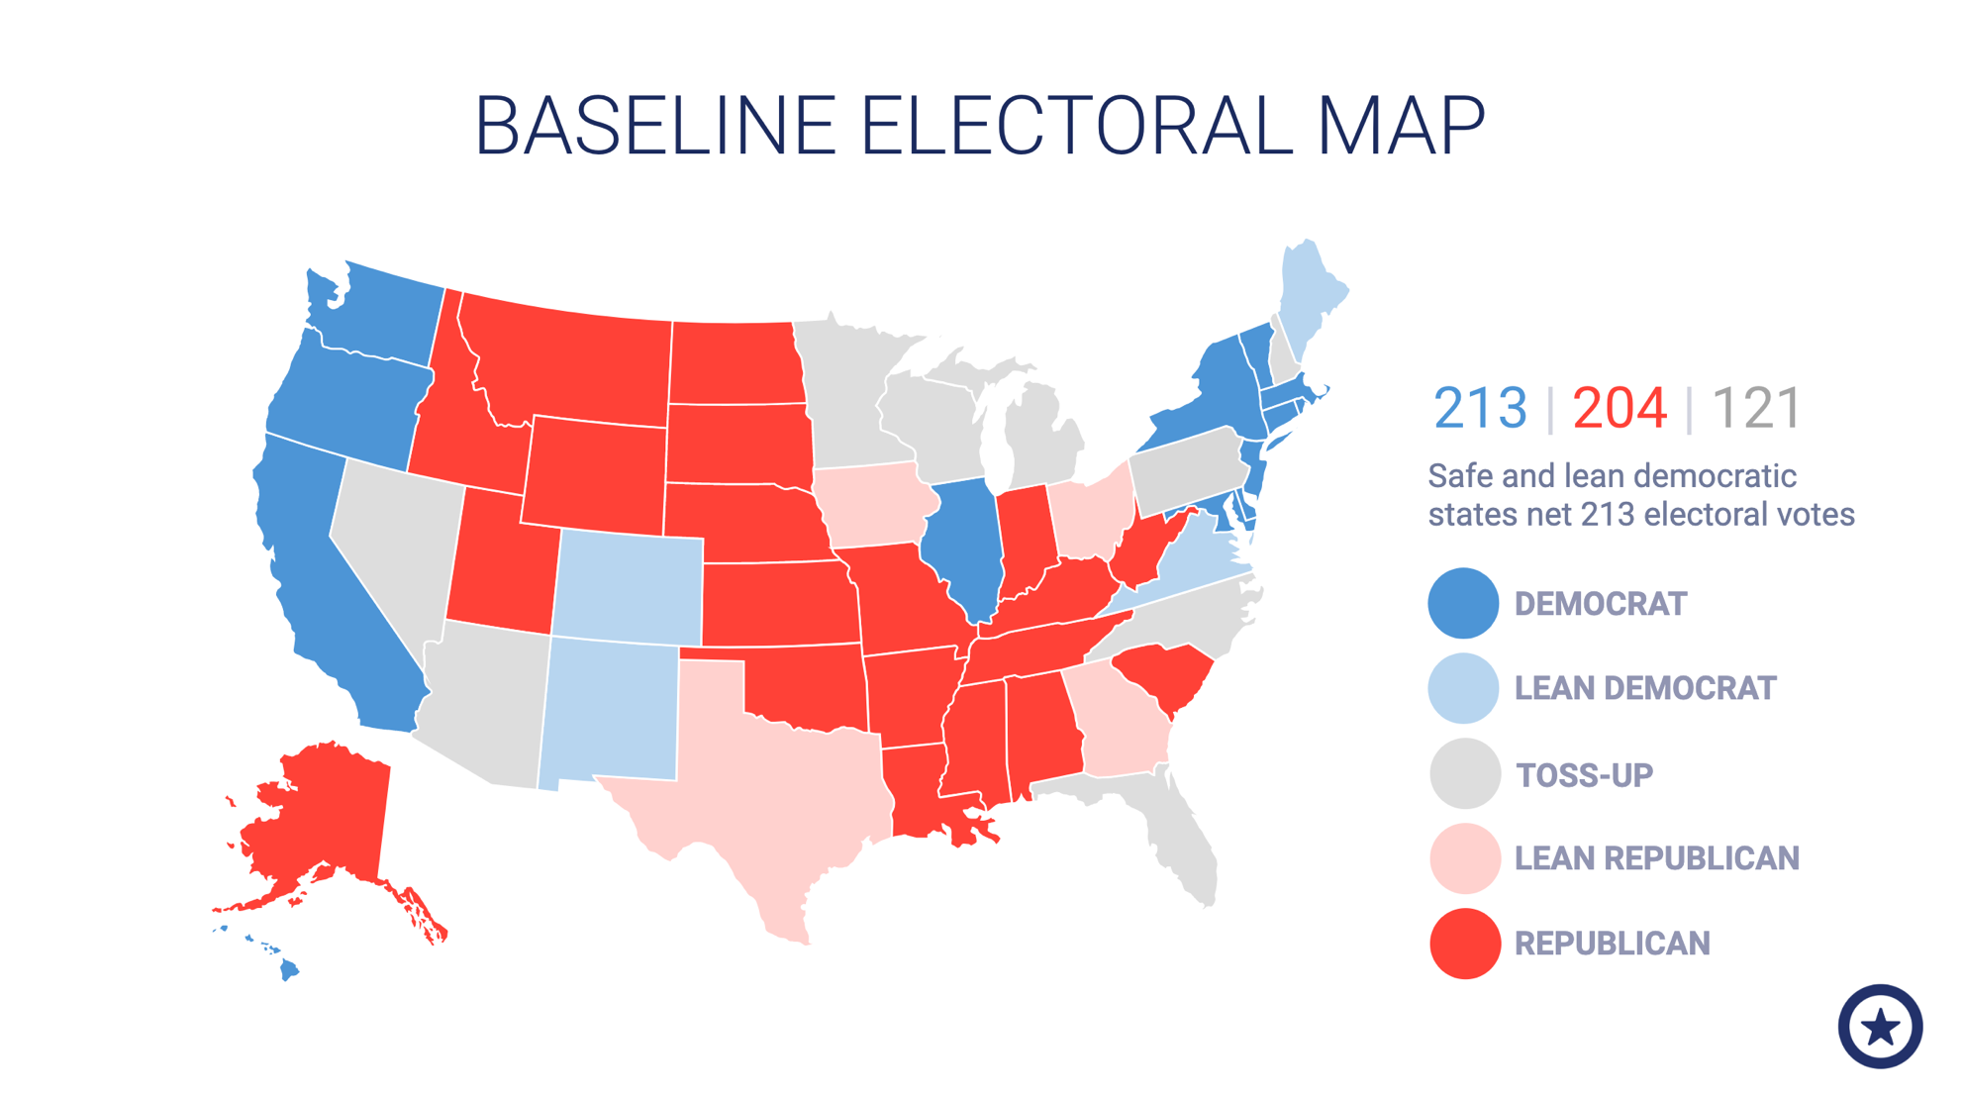

Slide 19
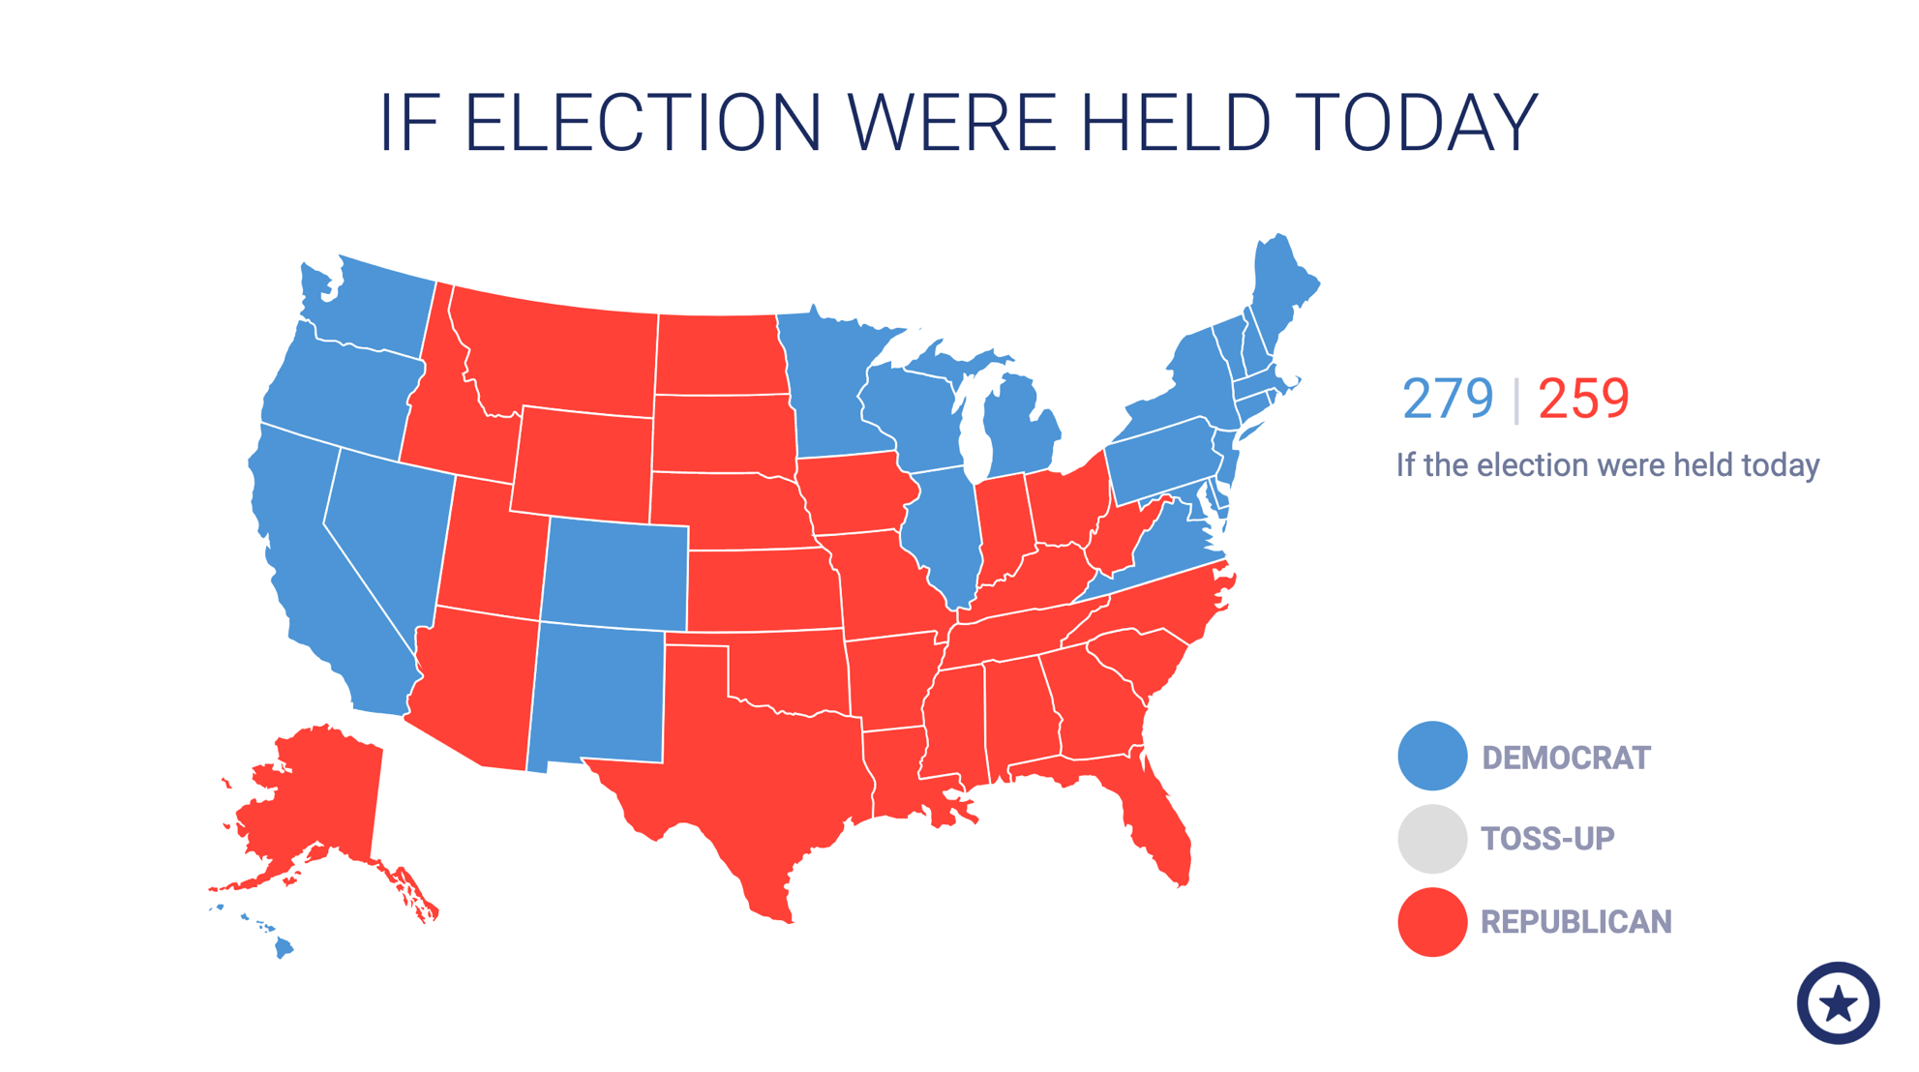

Slide 20
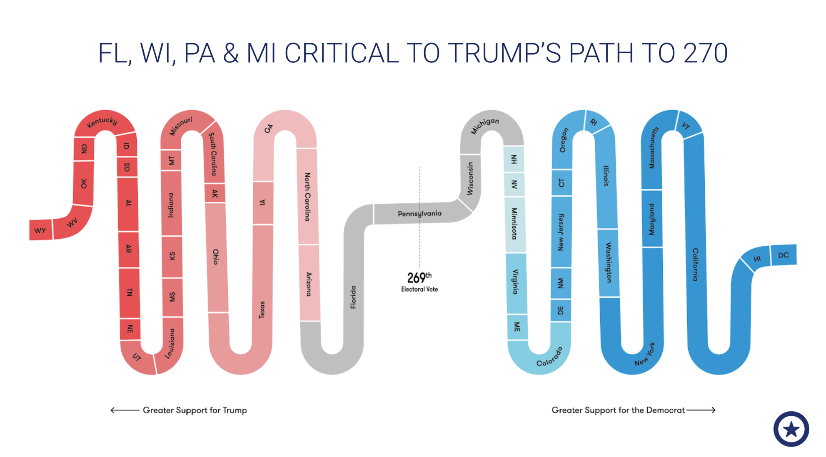

Slide 21
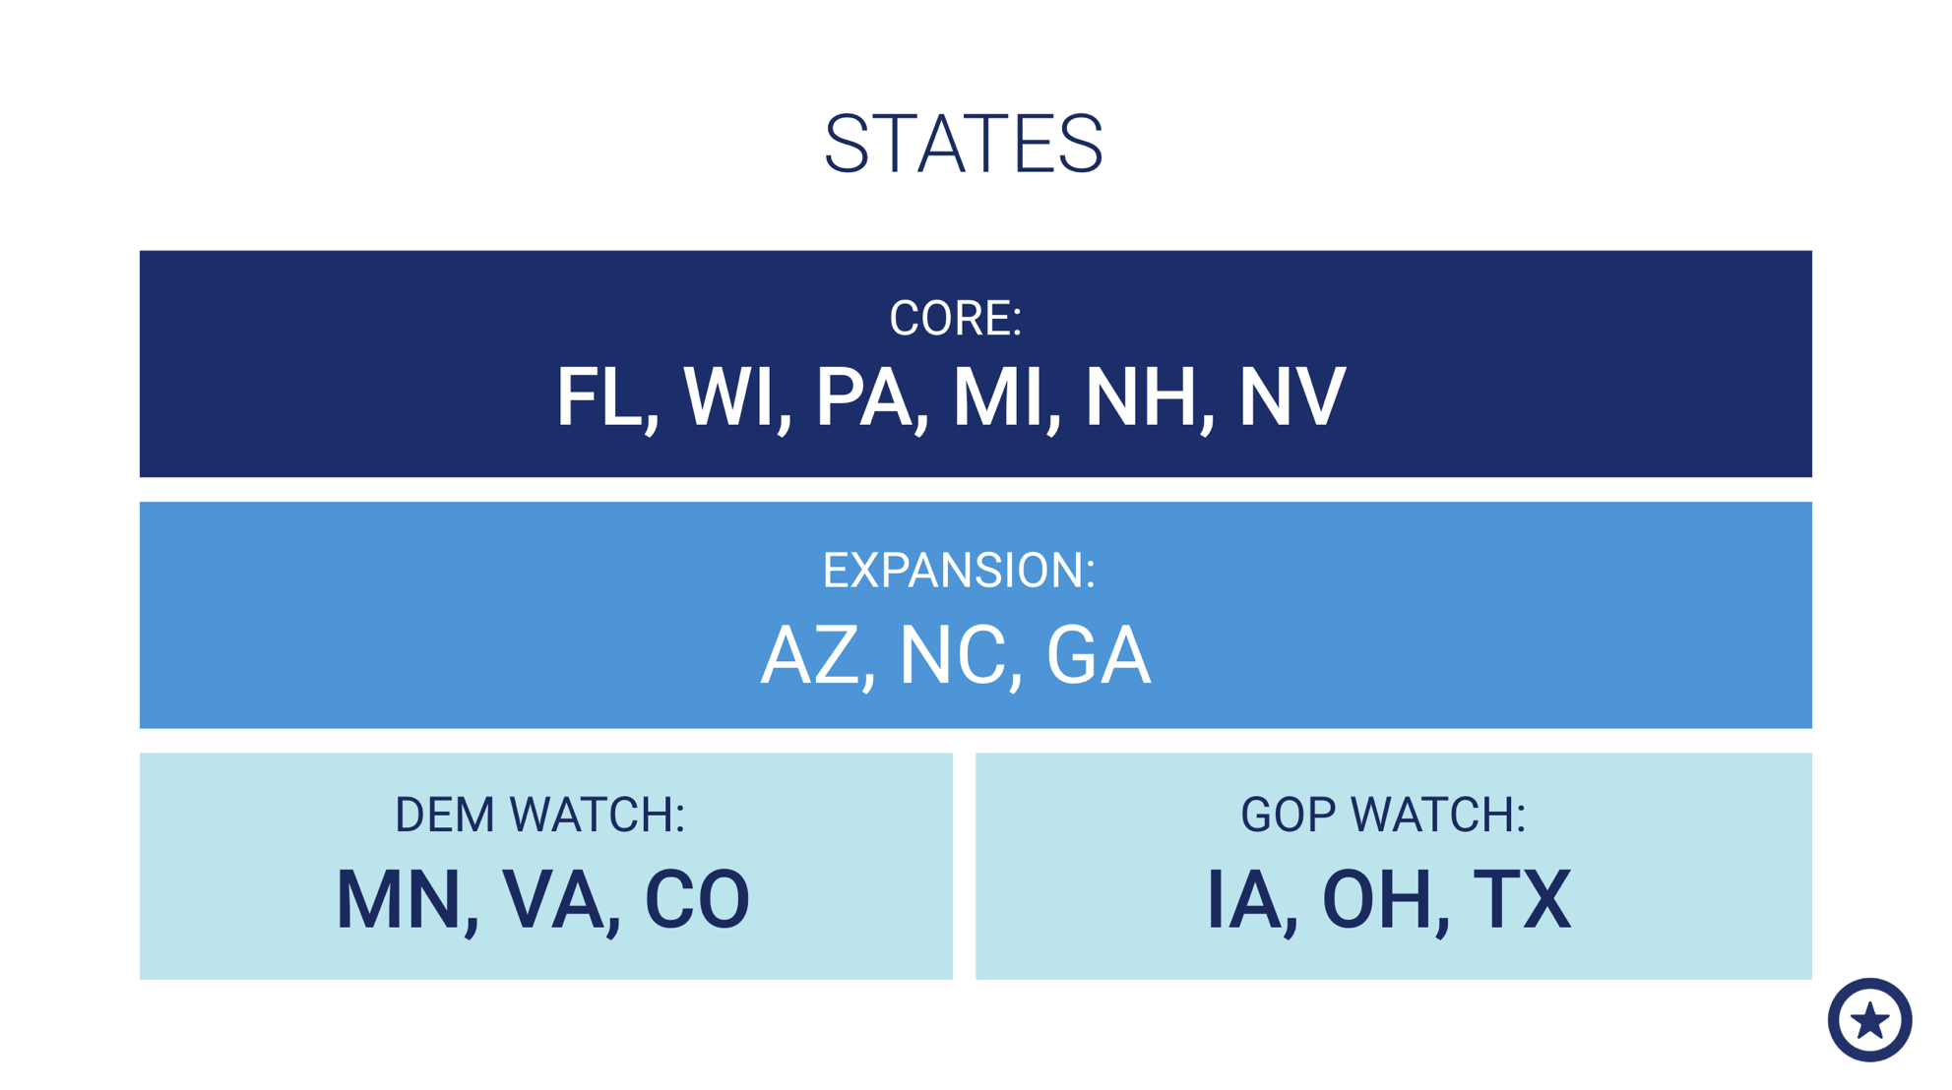

Slide 22
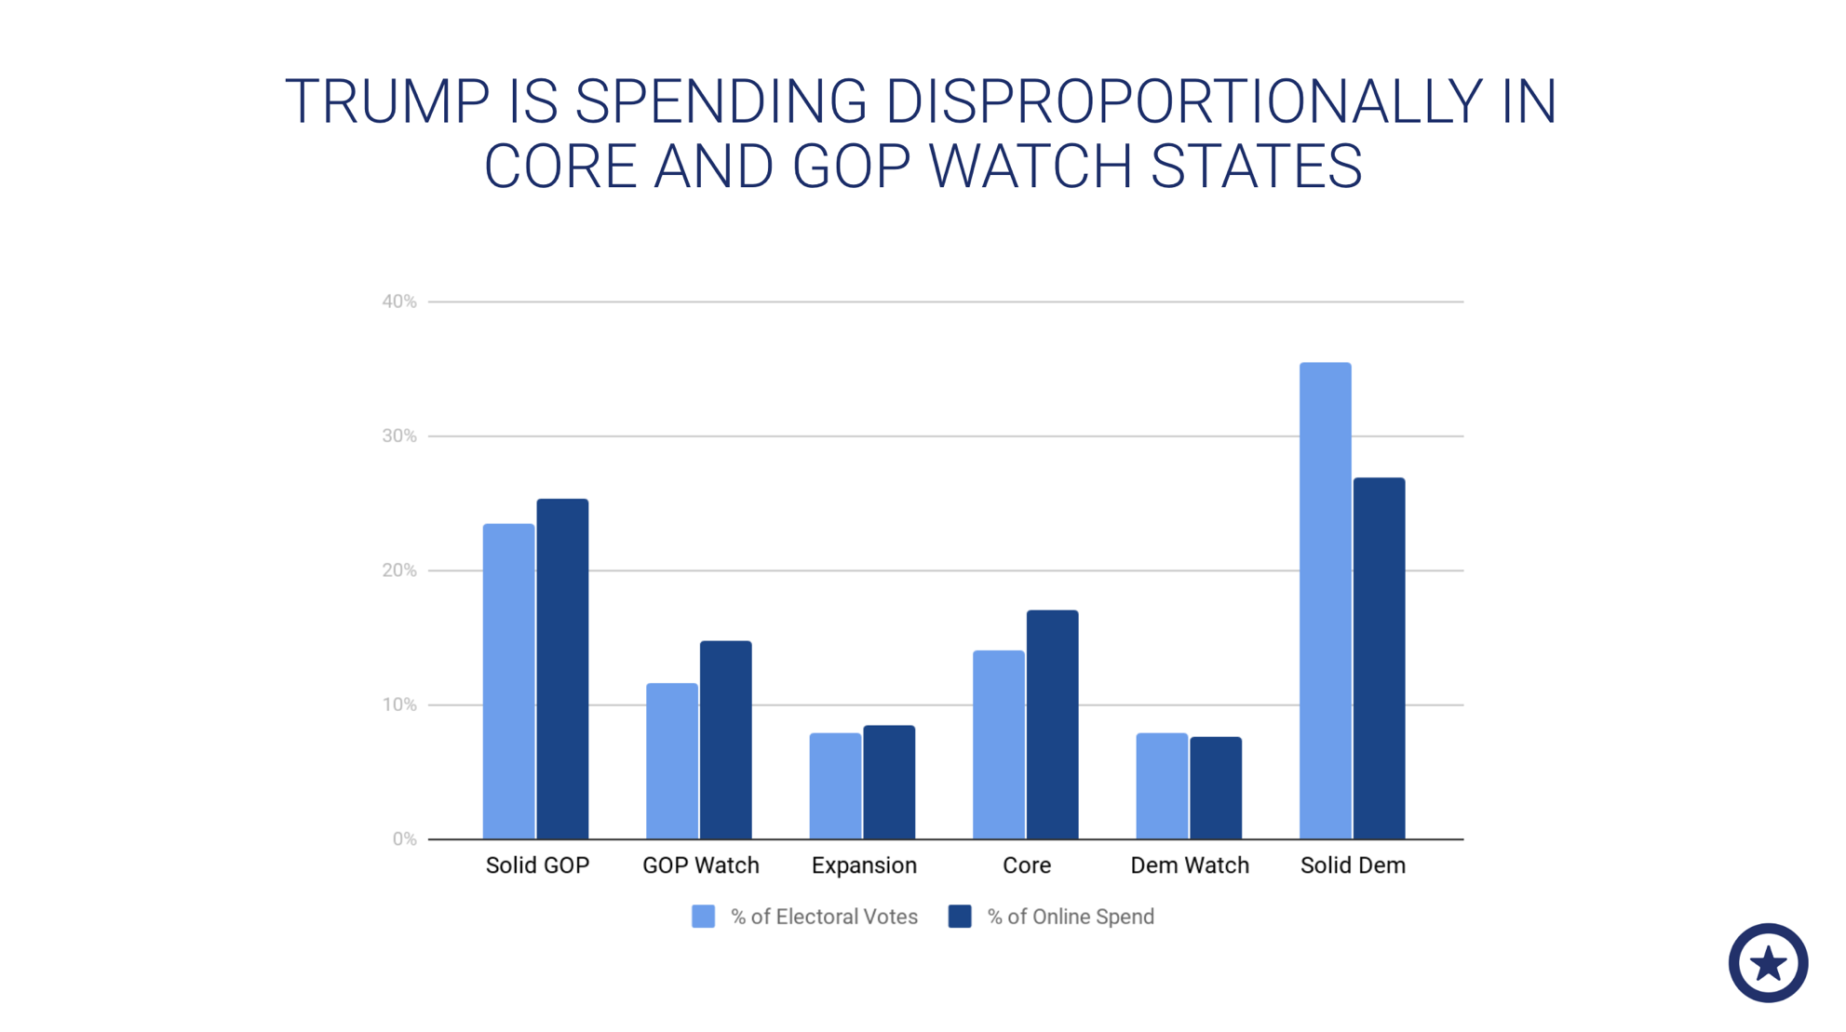

Slide 23
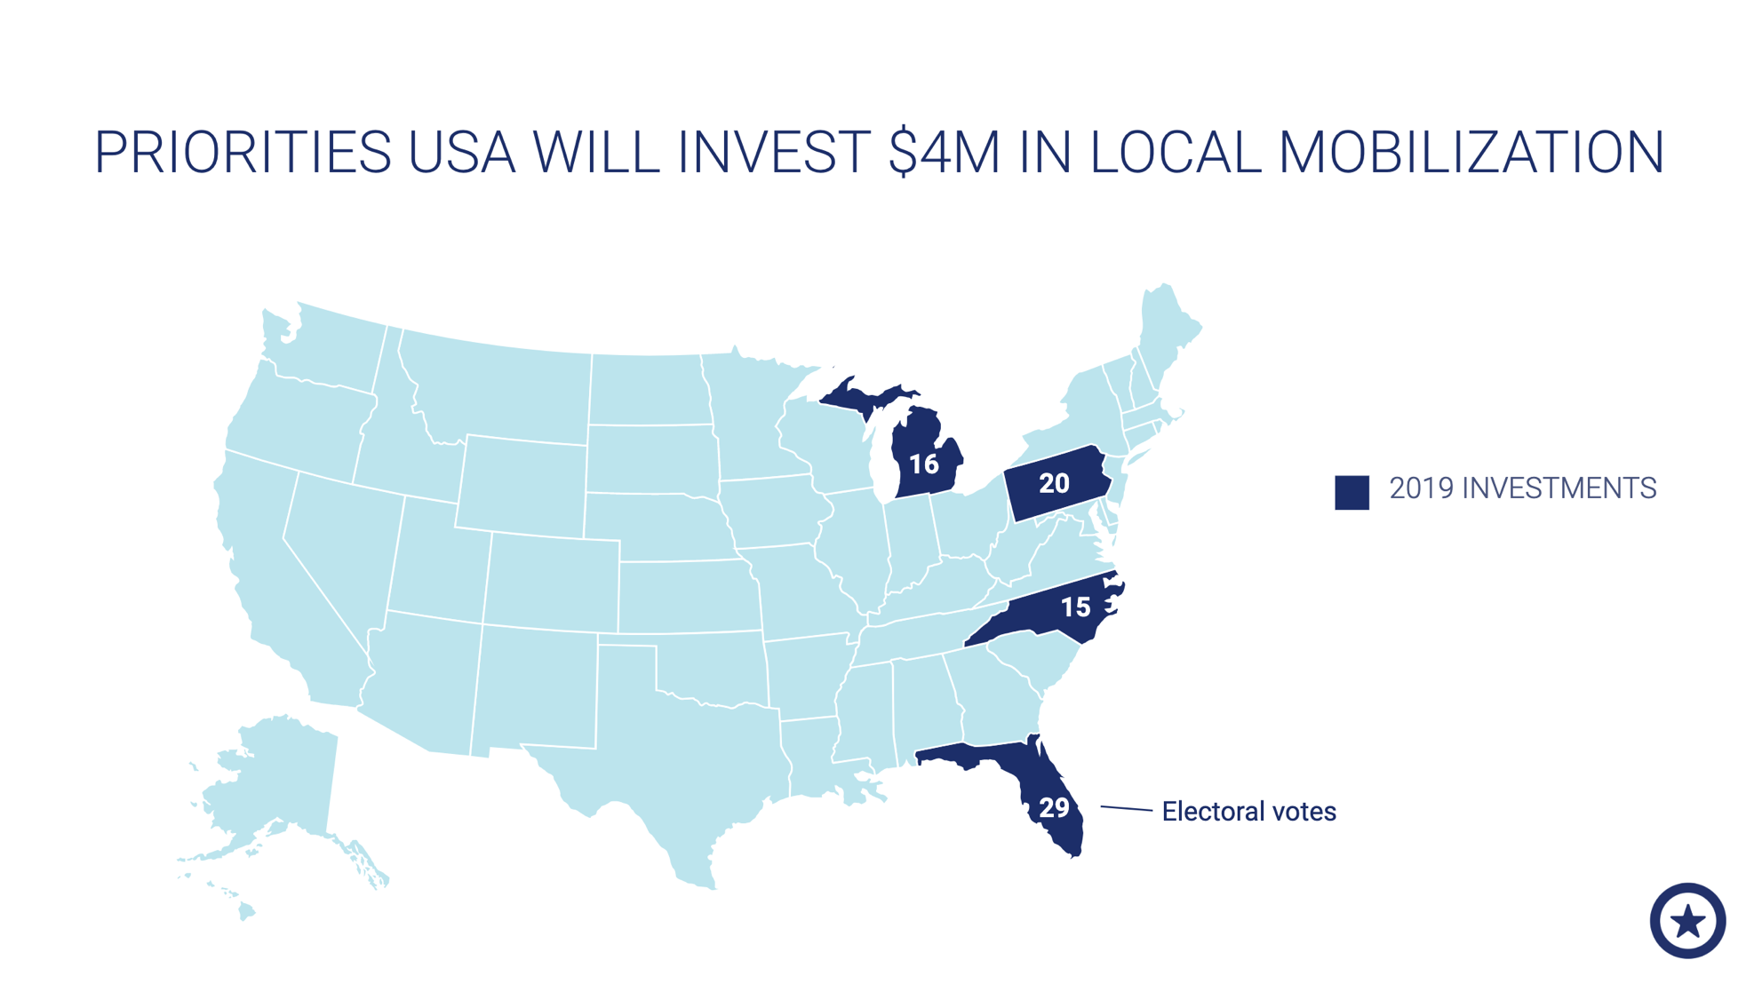

Slide 24
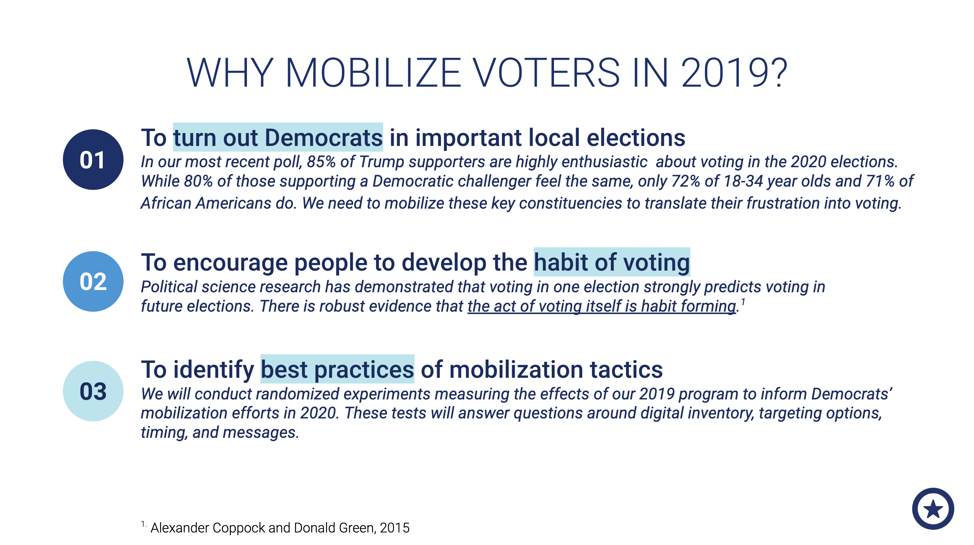

Slide 25
